Slide 1
Neural Networks Module 3
Shilpa Mehta

Slide 2
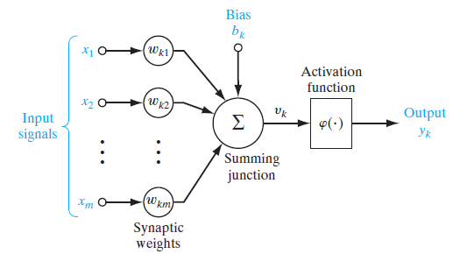
Nonlinear model of a neuron, labeled k. Typically, the normalized amplitude range of the output of a neuron is written as the closed unit interval [0,1], or, alternatively, [-1,1].

Slide 3


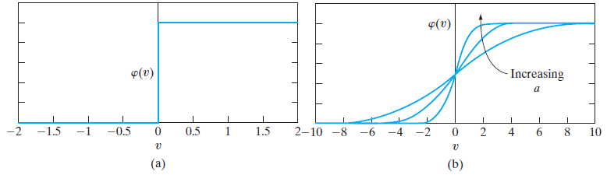
Types of Activation Function {WKT y = φ(v)} [graphs derived in class notes]
(a) Threshold function. (b) Sigmoid function for varying slope parameter

Slide 4
NEURAL NETWORKS VIEWED AS DIRECTED GRAPHS – contd.
To sum up, we have three graphical representations of a neural network:
• block diagram, providing a functional description of the network;
• architectural graph, describing the network layout;
• signal-flow graph, providing a complete description of signal flow in the network.

Slide 5
NETWORK ARCHITECTURES
Single-Layer Feedforward Networks
Multilayer Feedforward Networks
Recurrent Networks {with and without self feedback/ hidden nodes}

Slide 6
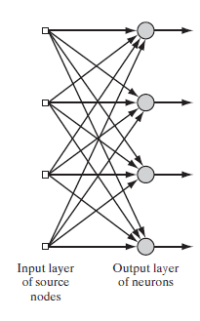
Single layer of neurons.

Slide 7
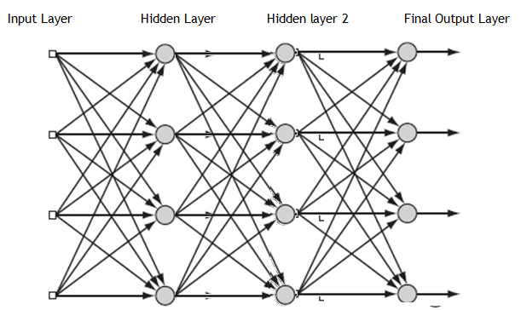
Multi Layer Perceptron

Slide 8
MLP
It is used for NON DIRECT or NON LINEARLY SEPARABLE problems
EXAMPLE is XOR gate;
One Input Layer; One or More hidden layer; One output layer
The following three points highlight the basic features of multilayer perceptrons:
The model of each neuron in the network includes a nonlinear activation function that is differentiable.
The network contains one or more layers that are hidden from both the input and output nodes.
The network exhibits a high degree of connectivity, the extent of which is determined by synaptic weights of the network.

Slide 9
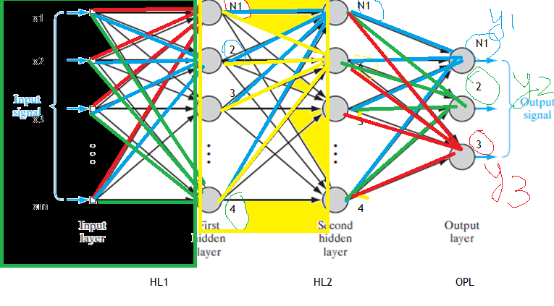
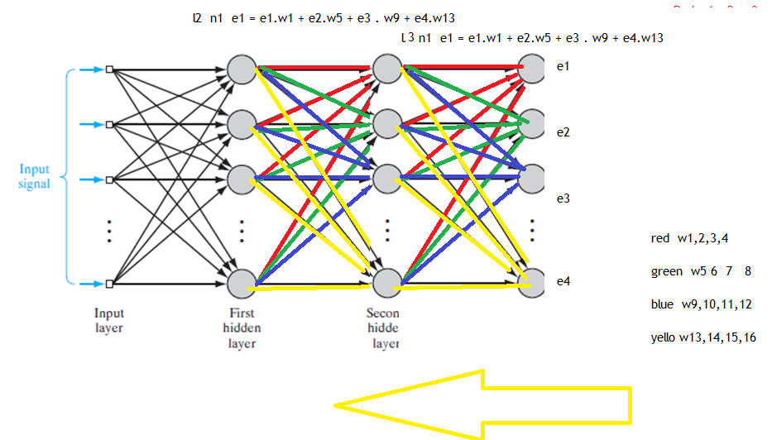
BPA
A popular method for the training of multilayer perceptrons is the back-propagation algorithm, which includes the LMS algorithm as a special case.
The training proceeds in two phases:
1. In the forward phase, (left to right) the synaptic weights of the network are fixed ; input signal is propagated through the network, layer by layer, till it reaches output. Thus, in this phase, changes are confined to the activation potentials and outputs of the neurons in the network.
2. In the backward phase (right to left), an error signal is produced by comparing the output of the network with a desired response. The resulting error signal is propagated through the network, again layer by layer, but this time the propagation is performed in the backward direction.
In this second phase, successive adjustments are made to the synaptic weights of the network. Calculation of the adjustments for the output layer is straightforward, but it is much more challenging for the hidden layers.
FORWARD PATH for signal
Backward path for error

Slide 10
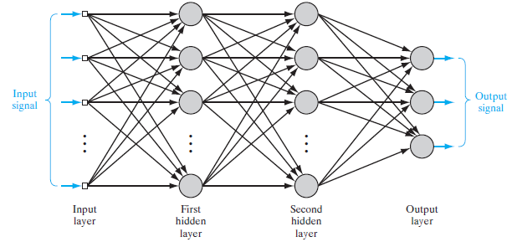
SOME PRELIMINARIES of MLP

Slide 11
SOME PRELIMINARIES of MLP contd.
1. Function Signals. The input signal (stimulus) that comes in at the input end of the network, propagates forward (neuron by neuron) through the network, and emerges at the output end of the network as an output signal.
It is presumed to perform a useful function at the output of the network.
At each neuron of the network through which a function signal passes, the signal is calculated as a function of the inputs and associated weights applied to that neuron.
The function signal is also referred to as the input signal.
2. Error Signals. An error signal originates at an output neuron of the network and propagates backward (layer by layer) through the network.
Called “error signal” because its computation by every neuron of the network involves an error-dependent function in one form or another.

Slide 12
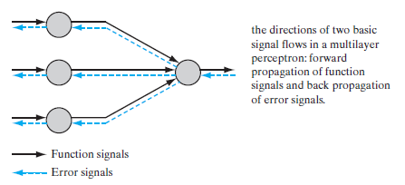
SOME PRELIMINARIES of MLP contd.

Slide 13
Job of the Hidden Neurons
The hidden neurons act as feature detectors;
As the learning process progresses across MLP, the hidden neurons begin to gradually “discover” the salient features that characterize the training data.
They do so by performing a nonlinear transformation on the input data into a new space called the feature space.
In this new space, the classes of interest in a pattern-classification task, for example, may be more easily separated from each other than could be the case in the original input data space.
Indeed, it is the formation of this feature space through supervised learning that distinguishes the multilayer perceptron from Rosenblatt’s perceptron.

Slide 14
Credit-Assignment Problem
Basically, the credit-assignment problem is the problem of assigning credit or blame for overall outcomes to each of the internal decisions made by the hidden computational units of the distributed learning system,
Recognizing that those decisions are responsible for the overall outcomes
In a multilayer perceptron using error-correlation learning, the credit-assignment problem arises because the operation of each hidden neuron and of each output neuron in the network is important to the network’s correct overall action on a learning task of interest.
Example if the subject DIP result is bad – error propagates backward to DSP, S&S, Maths in that order

Slide 15



BATCH LEARNING AND ON-LINE LEARNING
Consider an MLP illustrated in Fig
Let the training data set be available as
Let y_{j}(n) denote the function signal produced at the
output of neuron j in the output layer by stimulus x(n) at input layer.
Correspondingly, the error signal of neuron j is defined by
where dj(n) is the j^{th} element of the desired-response vector d(n)
The instantaneous error energy of neuron j is
The total instantaneous error energy of the whole network is
where the set C includes all neurons in output layer

Slide 16

BATCH LEARNING AND ON-LINE LEARNING contd..
With the training sample consisting of N examples,
the error energy averaged over the training sample,
or the empirical risk, is
The instantaneous the average error energy, are both functions of all the adjustable synaptic weights (i.e., free parameters) of the MLP
We may identify two different methods— batch learning and online learning
Batch Learning
adjustments to the synaptic weights of the MLP are performed after the presentation of all the N examples in the training sample t that constitute one epoch of training
the cost function for batch learning is defined by the average error energy.
Adjustments to the synaptic weights are made on an epoch-by-epoch basis
for each training epoch, the examples in the training sample are randomly shuffled.
On-line Learning
the synaptic weights of the MLP are performed on an example-by-example basis.
The cost function to be minimized is therefore the total instantaneous error energy e(n)

Slide 17
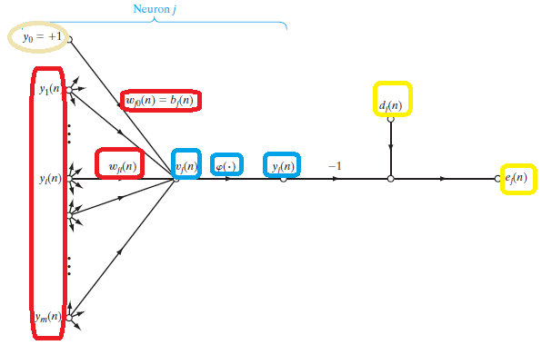

THE BACK-PROPAGATION ALGORITHM
It is an on-line learning algorithm for the supervised training of MLP
consider Fig. which depicts neuron j being fed by a set of function signals produced by a layer of neurons to its left.
The induced local field v_{j}(n) is

Slide 18
Terminology
Tau = τ = { X (n), d (n)} for n = 1 to N {both x and d are now vectors}
X(n) = [x0,x1,x2…..xm] ^{T} and d(n) = [d0,d1,d2,d3…..dL] ^{T} where m is the number of inputs and L number of outputs
Y _{j} (n) = calculated actual output of neuron “j” for iteration “n”
e _{j} (n) = d _{j} (n) – y _{j} (n)
While discussing any given hidden layers, we will use subscripts i, j, k for previous, current and next layers respectively
Except Input layer has only 2 subscripts (i an j) Output layer also has only 2 subscripts (j and k)

Slide 19
Partial derivatives
If y is a function of x
If x is a function of p
If p is a function of q
Then dy / dq = (dy/dx) . (dx/dp) . (dp/dq)
Example y = 10x sq; x = cos (theta)
Dy/dtheta = (Dy / dx)(dx/d theta) = (10.2x). (-sin (theta)) = -20xsin(theta)
= -10.2.cos theta in theta = -10sin(2 theta)

Slide 20
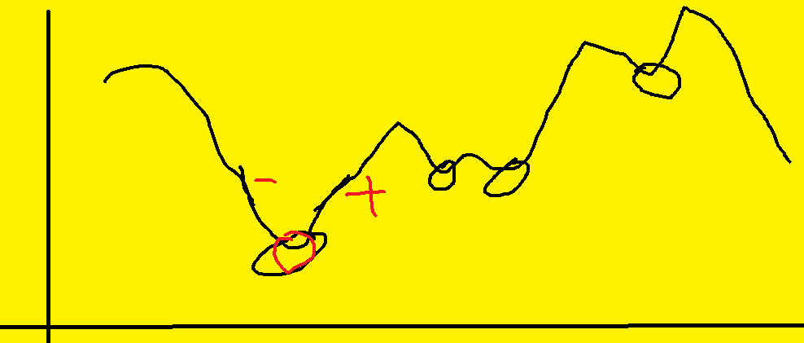
Minima – if we have 1d problem – dy/dx = 0 at minima

Slide 21

BPA Contd..
function signals produced by a layer of neurons to its left. The induced local field vj(n) (at the input of the activation function) associated with neuron j is therefore
, where m is the total number of inputs (excluding the bias) and wj0 is bias bj to neuron j.
Hence, the function signal yj(n) at the output of neuron j at iteration n is
The BPA algorithm applies a correction Δwji(n) to the synaptic weight wji(n), which is proportional to the partial derivative
According to the chain rule of calculus, we may express this gradient as
The partial derivative represents a sensitivity factor, determining the direction of search in weight space for the synaptic weight wji.
WKT from previous slides (5.1) ; e _{j} (n) = d _{j} (n) – y _{j} (n) ; (5.2)
(5.3) and (5.4)
6. Differentiating by chain rule

Slide 22
BPA Contd..
Differentiating both sides of Eq. (5.1) with respect to ej(n), we get
Differentiating both sides with respect to yj(n), we get
Next, differentiating with respect to vj(n), we get
where the use of prime (on the right-hand side) signifies differentiation with respect to the argument.
Finally, differentiating Eq. (4.6) with respect to wji(n) yields
The use of yields

Slide 23
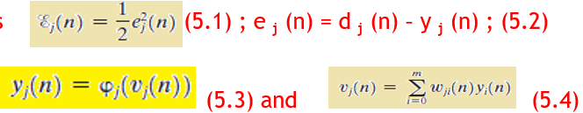
Differentiating
(d eps / de) ( de / d y) (dy / dv) (dv / dwji)
➔ = (d eps / de) ( de / d y) (dy / v) (dv / dwji)
= ( (1/2)(2e)) . (-1) . (φ ‘) . (y_{i}(n))
( d/dwji ( wj0 yo + w j1 y1 + wj2 y2 + w j3 y3 + ….. +
+ wj(i-1) y(i-1) + wj I yi + wj(i+1)y(i+)+ ….. +….. +wjm ym) )
= ( (1/2)(2 e)) . (-1) . (φ ‘) . (0+0+0….+yi+0+0+….+0) = [ - φ’ y_{i} ]

Slide 24
FULL GRADIENT = Slope of eps wrt wji
(deps) / dwji = (deps/de) (dej/ dyj) (dy/dv) (dv / dwji)
= ((1/2) 2ej) (-1) (φ’) ( 0+0+0+0 ….. +d/dwji (wji.yi) +0+0+0+…)
= - ej φ’ wji

Slide 25

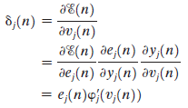
BPA Contd..
This yields
The correction wji(n) applied to wji(n) is defined by the delta rule, or Change in weight = (LR).(Gradient of error WRT weights) = - η e_{j} φ’ y_{i}
i.e. Δw _{ji} (n) = - η e_{j} φ’ y_{i} where is the learning-rate parameter
where the local gradient is defined by
i.e. slope wrt only local induced field,
not till weights
we note that a key factor for the weight adjustment Δ wji(n) is error ej(n)
Now the problem comes to HOW to find ej for hidden layers s their output signal is invisible to external world
Case 1 Neuron j Is an Output Node – yj is visble; ej can b directly found
Case 2 Neuron j Is a Hidden Node

Slide 26



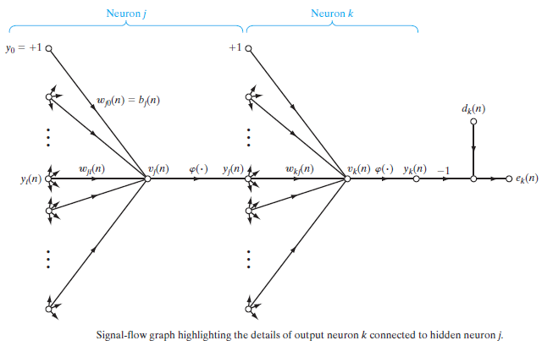

BPA Contd.. Case 2 Neuron j Is a Hidden Node
we may redefine the local gradient j(n) for hidden neuron j as
To calculate the partial derivative WKT
Differentiating this we get

Slide 27




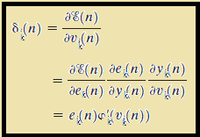


BPA Contd.. Case 2 Neuron j Is a Hidden Node
Next we use the chain rule for the partial derivative
However,
Hence,
WKT for neuron k, the induced local field is =
Hence differentiating this we get
Substituting (3) and (5) in (1) we get
= =

Slide 28
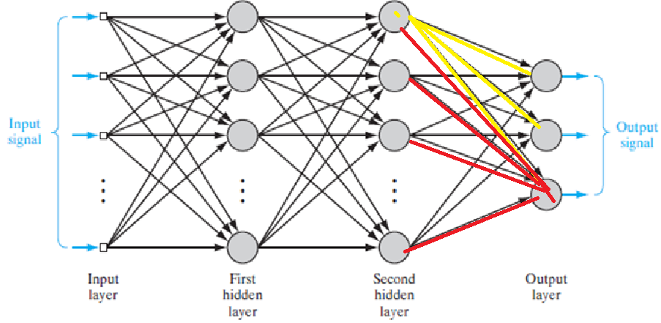

Slide 29


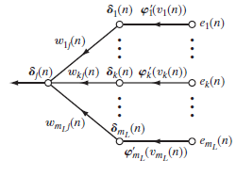

BPA Contd..
Formula for local gradient of hidden layer going backwards
WKT
back-propagation formula for the
local gradient δj(n), is described by
The factor φ’(vj(n)) involved in the computation of the local gradient j(n) depends solely on the activation function associated with hidden neuron j.

Slide 30
The Two Passes of Computation:
Forward “function evauation” path
Backward “Error correction” path

Slide 31

Activation Function – types & Rate of Learning
We nee continuously differentiable Act. Func
1. Logistic Function. This form of sigmoidal nonlinearity, in its general form,
2. Hyperbolic tangent function:
Rate of Learning or η :
We use half if we take T=+1 and F = -1
We use one if we take T=+1 and F = 0

Slide 32
Stopping Criteria
In general, the back-propagation algorithm cannot be shown to converge, and there are no well-defined criteria for stopping its operation. Rather, there are some reasonable criteria, each with its own practical merit, that may be used to terminate the weight adjustments. To formulate such a criterion, it is logical to think in terms of the unique properties of a local or global minimum of the error surface.3 Let the weight vector w* denote a minimum, be it local or global. A necessary condition for w* to be a minimum is that the gradient vector g(w) (i.e., first-order partial derivative) of the error surface with respect to the weight vector w must be zero at w w*. Accordingly, we may formulate a sensible convergence criterion for back-propagation learning as follows
The back-propagation algorithm is considered to have converged when the Euclidean norm of the gradient vector reaches a sufficiently small gradient threshold.
The drawback of this convergence criterion is that, for successful trials, learning times may be long. Also, it requires the computation of the gradient vector g(w).
Another unique property of a minimum that we can use is the fact that the cost function is stationary at the point w w*.We may therefore suggest a different criterion of convergence:
The back-propagation algorithm is considered to have converged when the absolute rate of change in the average squared error per epoch is sufficiently small.

Slide 33
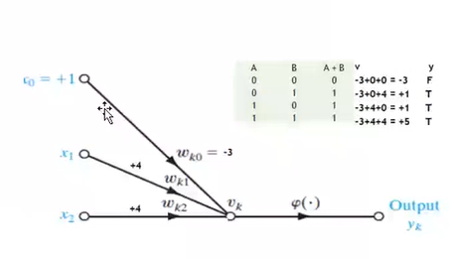
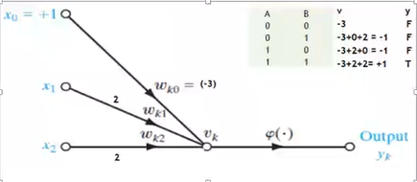
SAMPLE MLP PROBLEM – XOR GATE XOR with MLP
What is XOR?
Xor IS TRUE IFF (OR IS TRUE) &&& ( AND IS FALSE)

Slide 34
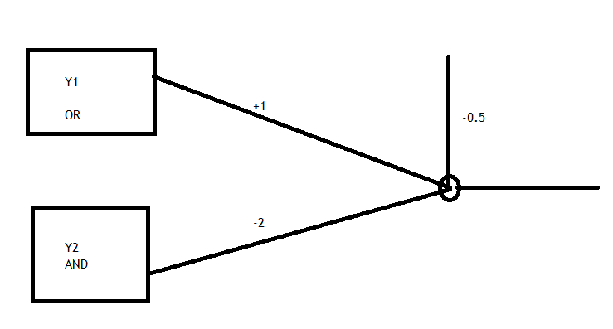
Xor

Slide 35
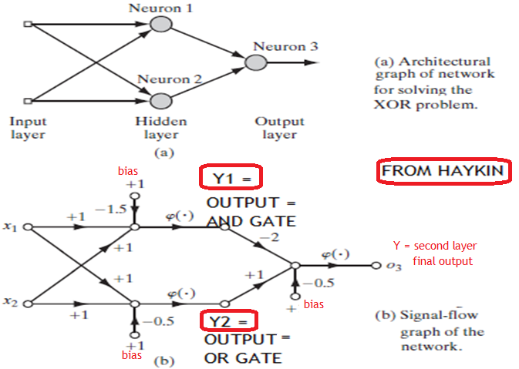
XOR COMBINED
2 STAGES

Slide 36
What is an Algorithm
The procedure of how a program will go
EXACT STEP BY STEP INSTRUCTIONS that I should give to my machine to achieve a goal
It either works or fails
Heuristic s a method for convenience
It is not deterministic
Estimated and approximate solutions
Michio Kaku on AI: levels and when to stop

Slide 37
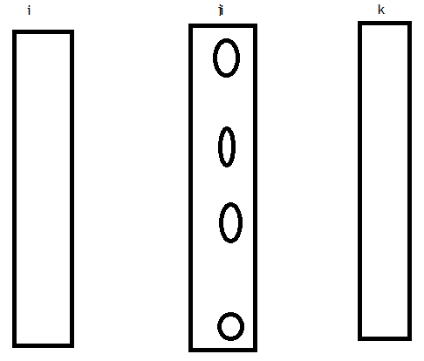
Matrix method of writing
1
2
3
:
m
Previous layer I Current layer j Next layer k

Slide 38
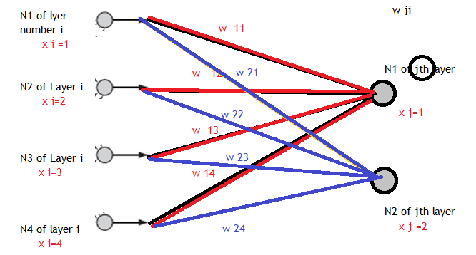
Figure : i is previous (feeding) layer j is current layer being calculated
First subscript in w is for j and second subscript is i

Slide 39
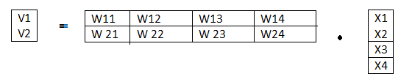
WRITING Forward path IN MATRIX FORM
V _{j} = Σ w _{j i} x _{i}
Where
j is the neuron number in CURRENT LAYER and
i is e feeding neuron in the PREVIOUS LAYER
V vector has 2 rows for output layer
X vector (also written y vector) has 4 rows for previous layer size
W vector has 2 rows corresponding to vj and 4 columns correnponding to xi
V1 = w11 x1 + w 12 x2 + w 13 x3 + w14 x4
V2 = w21 x1 + w22 x2 + w23 x3 + w24 x4

Slide 40
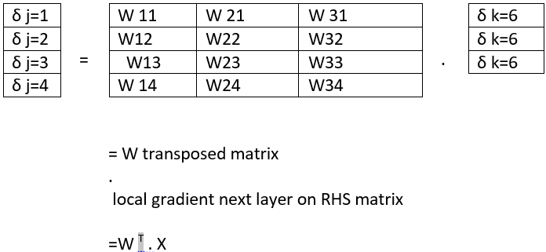
WRITING IN Backward error Path in MATRIX FORM
Refer figure
Local Gradient propagates backwards
δ = W ^{T} X

Slide 41
Computation in MLP
Forward computation

Slide 42
XOR
A | B | A (+) B
0 | 0 | 0
0 | 1 | 1
1 | 0 | 1
1 | 1 | 0

Slide 43
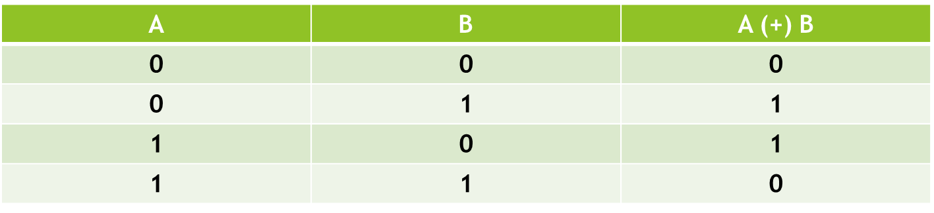
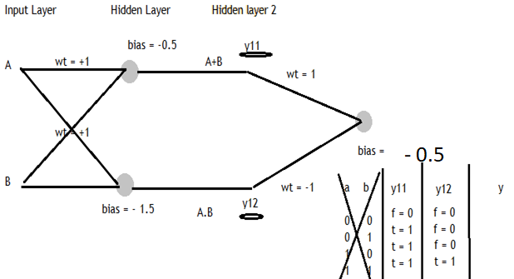
XOR gives TRUE iff (OR is true) and simultaneously (AND is False)

Slide 44
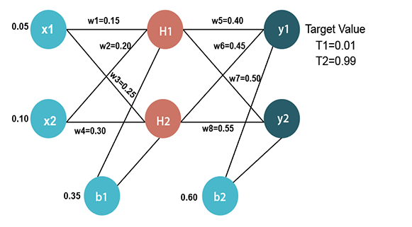
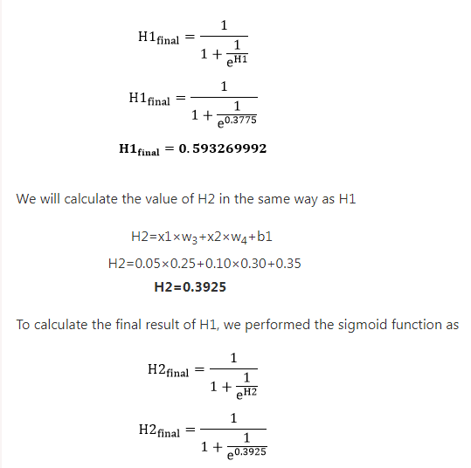
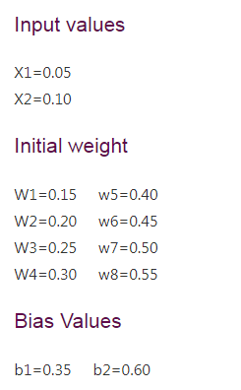
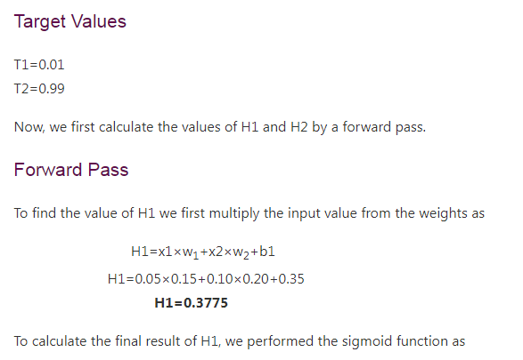


Slide 45
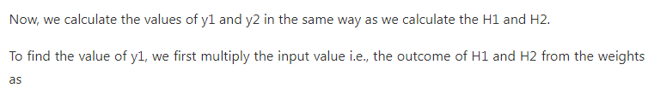
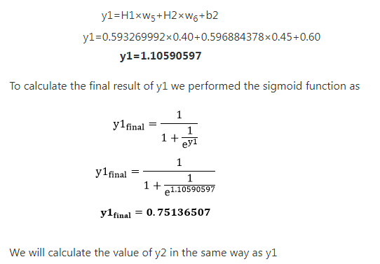
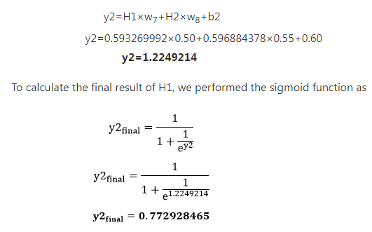

Slide 46
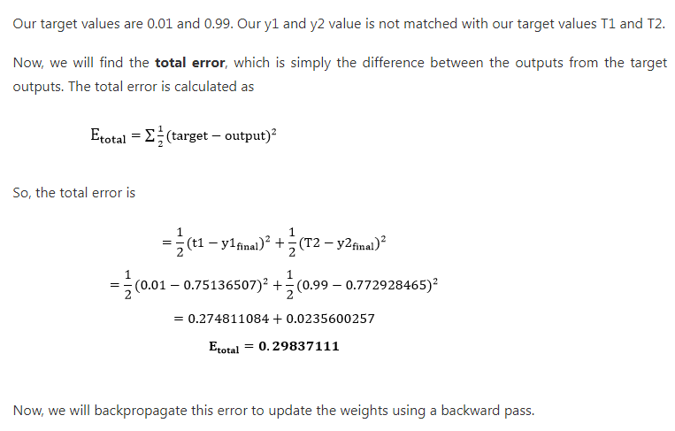

Slide 47
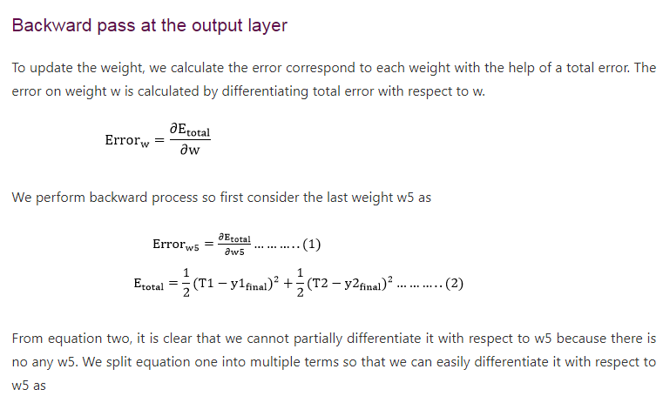

Slide 48
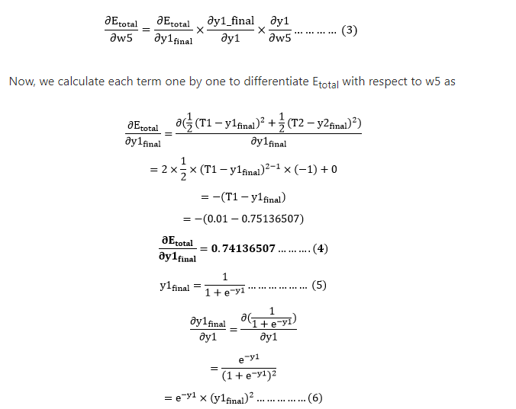

Slide 49
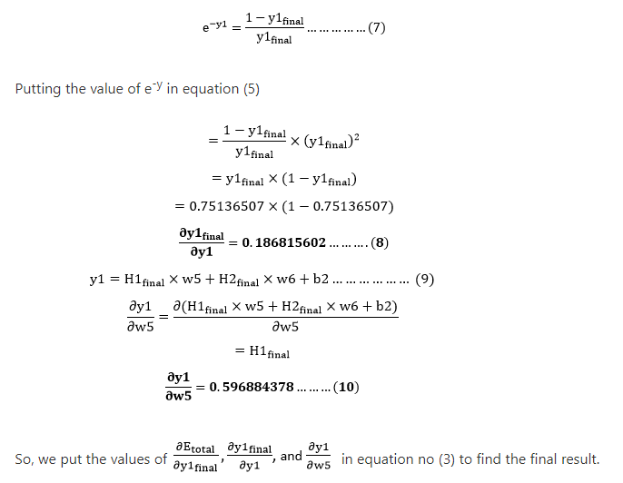
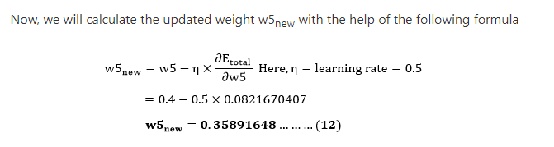
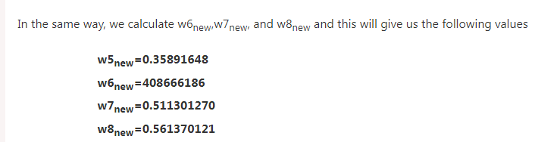
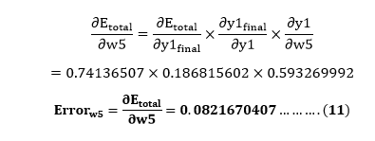

Slide 50
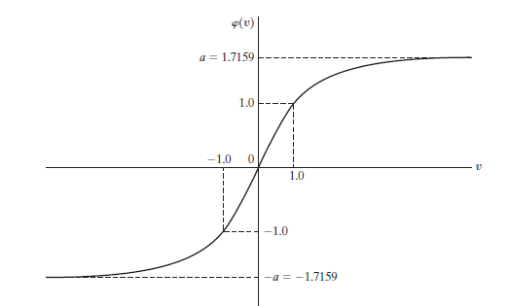
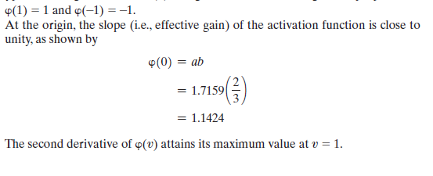
Heuristics for making back propagation perform better
1. Stochastic versus batch update : the stochastic (sequential) mode of back-propagation learning (involving pattern-by-pattern updating) is computationally faster than the batch mode.
2. Maximizing information content. As a general rule, every training example presented to the back-propagation algorithm should be chosen on the basis that its information content is the largest possible for the task at hand (LeCun, 1993).Two ways of realizing this choice are as follows:
• Use an example that results in the largest training error.
• Use an example that is radically different from all those previously used.
3. Activation function. In so far as the speed of learning is concerned, the preferred choice is to use a sigmoid activation function

Slide 51
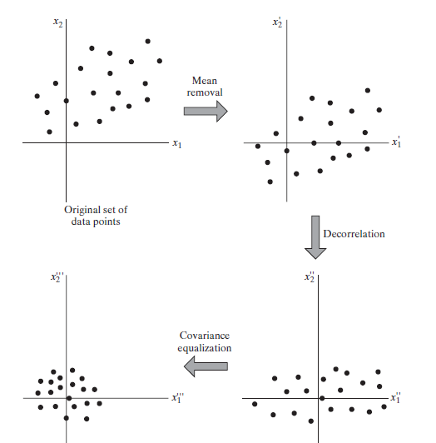
4. Normalizing the inputs. Each input variable should be preprocessed so that its mean value, averaged over the entire training sample, is close to zero, or else it will be small compared to its standard deviation

Slide 52
5. Initialization. A good choice for the initial values of the synaptic weights and thresholds of the network can be of tremendous help in a successful network design. The key question is: What is a good choice?
6. Learning from hints The process of learning from examples may be generalized to include learning from hints, which is achieved by allowing prior information that we may have about the function f(·) to be included in the learning process (Abu-Mostafa, 1995). Such information may include invariance properties, symmetries, or any other knowledge about the function f(·) that may be used to accelerate the search for its approximate realization and, more importantly, to improve the quality of the final estimate
7. Learning rates. All neurons in the multilayer perceptron should ideally learn at the same rate. The last layers usually have larger local gradients than the layers at the front end of the network. Hence, the learning-rate parameter should be assigned a smaller value in the last layers than in the front layers of the multilayer perceptron. Neurons with many inputs should have a smaller learning-rate parameter than neurons with few inputs so as to maintain a similar learning time for all neurons in the network

